Slide 1
Predicting SAN JOSE HOME PRICES
AARON LOPEZ
CAPSTONE PROJECT JUNE 2017

Slide 2

The Problem
Mayor…"San Jose is facing an affordable housing crises.”
The average home now costs $1 million in San Jose
Are affordable housing policies working? ¯\_(ツ)_/¯
What should the first time home buyer do in the near term? ¯\_(ツ)_/¯

Slide 3
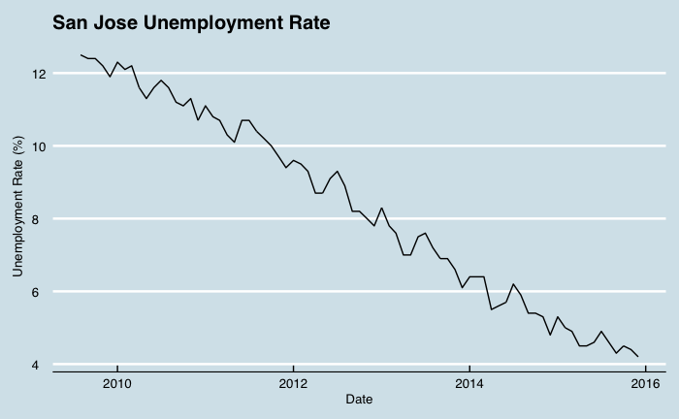
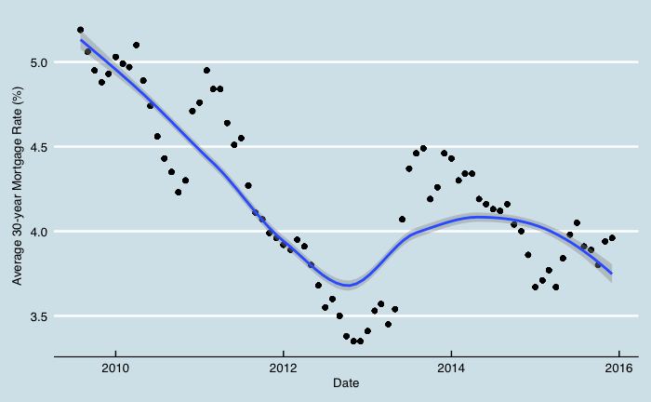
HOW DID WE GET HERE?
Post financial crisis 2007-2008
Rebound in the housing market
Low mortgage rates
High demand for Silicon Valley real estate

Slide 4
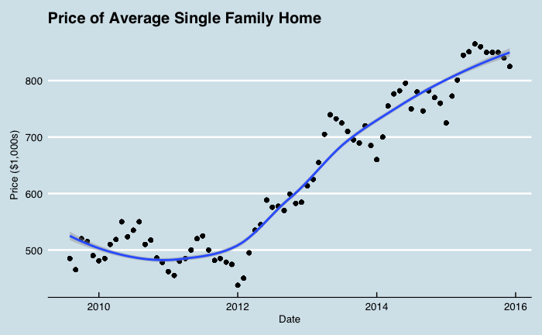
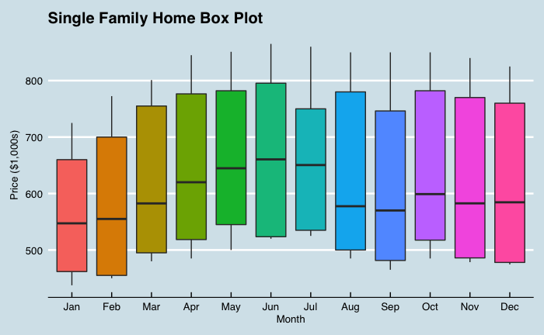
HOW DID WE GET HERE?
70% increase in average home prices since 2011 in San Jose
Local government policy, is it working?
Where will house prices go from here?

Slide 5
Approach to prediction
Predicting near term home prices will help track government affordable housing policy and assist potential home buyers
I will use three different models and determine which one is the best predictor of average home prices
Linear Regression
Tree Regression
ARIMA (autoregressive integrated moving average)
To determine the best predictor I will compare the root-mean-square error (RMSE) of each model, lowest score gives the most accurate predictions

Slide 6
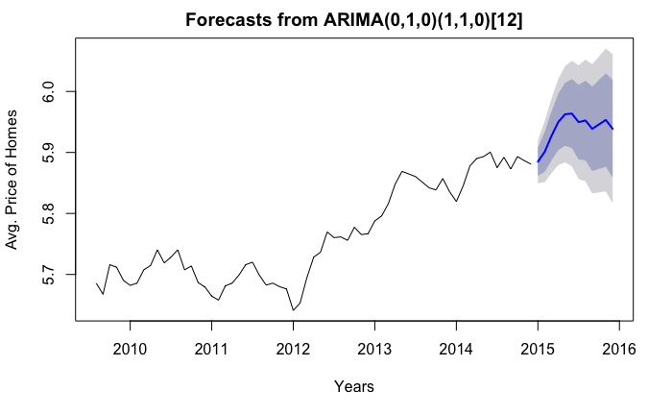
Approach to prediction
ARIMA (autoregressive integrated moving average)
This is a time series model
Past data to predict future data
RMSE 0.022528 (good)

Slide 7
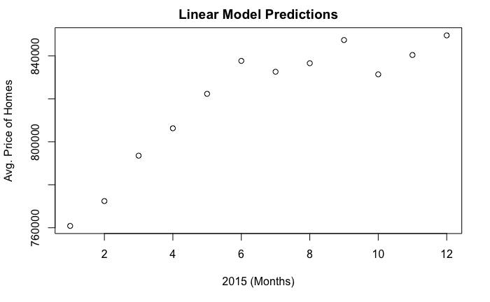
Approach to prediction
Linear Regression Model
Line of best fit to predict future prices
Variables include unemployment rate, mortgage rates, and average apartment rents
RMSE 0.012206 (better)

Slide 8
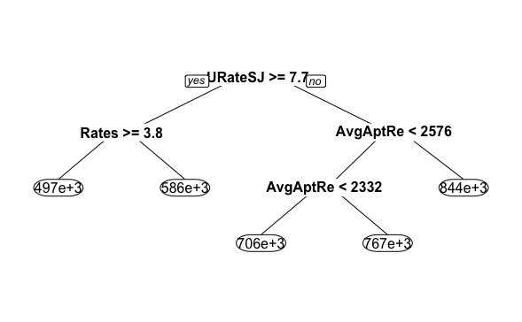
Approach to prediction
Tree Regression Model
Decision trees
Random data used to train and test the model predictions
RMSE 0.001140 (best)

Slide 9
Results and discussion
Average home prices are likely to increase in the near term
Seasonal trends reveal the best time to buy a home is in Jan/Feb and best time to sell is Jun/July
Further examination of government policy effects is needed
Model can be used to determine the effectiveness of new policies over time
Gathering more relevant variables to for a more robust data set will help improve the accuracy of the model

